Slide 1


Samorazvijajoči se sistemi na podlagi toka podatkov v modeliranju in vodenju
Seminarska naloga 1
Miha Ožbot
Mentor: prof. dr. Igor Škrjanc, univ. dipl. Inž. el.
Ljubljana, 14. april 2022

Slide 2
Samorazvijajoči se (inteligentni) sistemi
Samorazvijajoči se (inteligentni) sistemi (evolving inteligent systems) adaptirajo (adapt) tako svoje parametre kot tudi strukturo z enkratnim prehodom čez podatke (single-pass) [1] in v realnem času (real time) [2].
Okolje (environment), v katerem gradimo samorazvijajoči model, je neznano in model je zgrajen brez a priori informacij (središča rojev, števila pravil itd.).
Strukturo lahko sestavljajo: mehka pravila (fuzzy rules) [1,3], informacijske granule (information granules) [4,5], nevroni (neurons) [6], odločitvena drevesa (decision tree) [7], intervalni modeli (interval) idr.
Te strukture so uporabljene zaradi večje transparentnosti in lingvistične interpretabilnosti od drugih modelov črne škatle (black-box) [6].
[1]Angelov, P. P., & Filev, D. P. (2004). An Approach to Online Identification of Takagi-Sugeno Fuzzy Models. IEEE Transactions on Systems, Man, and Cybernetics, Part B: Cybernetics, 34(1), 484–498.
[2] Skrjanc, I. (2020). Cluster-Volume-Based Merging Approach for Incrementally Evolving Fuzzy Gaussian Clustering-eGAUSS+. IEEE Transactions on Fuzzy Systems, 28(9), 2222–2231.
[3] Dovžan, D., Logar, V., & Škrjanc, I. (2015). Implementation of an Evolving Fuzzy Model (eFuMo) in a Monitoring System for a Waste-Water Treatment Process. IEEE Transactions on Fuzzy Systems, 23(5), 1761–1776.
[4] Leite, D., Andonovski, G., Skrjanc, I., & Gomide, F. (2020). Optimal rule-based granular systems from data streams. IEEE Transactions on Fuzzy Systems, 28(3), 583–596.
[5] Leite, D., Costa, P., & Gomide, F. (2010). Granular Approach for Evolving System Modeling. Lecture Notes in Computer Science (Including Subseries Lecture Notes in Artificial Intelligence and Lecture Notes in Bioinformatics), 6178 LNAI, 340–349.
[6] Leite, D., Škrjanc, I., & Gomide, F. (2020). An overview on evolving systems and learning from stream data. Evolving Systems, 11(2), 181–198.
[7] Lemos, A., Caminhas, W., & Gomide, F. (2010). Evolving fuzzy linear regression trees. 2010 IEEE World Congress on Computational Intelligence, WCCI 2010.
Notes:
Samorazvijajoče se modele lahko razdelimo v različne kategorije gleda na njihovo strukturo, način učenja, nivo avtonomije adaptacije [39]
[3] Angelov, P. P., & Filev, D. P. (2004). An Approach to Online Identification of Takagi-Sugeno Fuzzy Models. IEEE Transactions on Systems, Man, and Cybernetics, Part B: Cybernetics, 34(1), 484–498.
[5] Dovžan, D., Logar, V., & Škrjanc, I. (2015). Implementation of an Evolving Fuzzy Model (eFuMo) in a Monitoring System for a Waste-Water Treatment Process. IEEE Transactions on Fuzzy Systems, 23(5), 1761–1776.
[7] Leite, D., Andonovski, G., Skrjanc, I., & Gomide, F. (2020). Optimal rule-based granular systems from data streams. IEEE Transactions on Fuzzy Systems, 28(3), 583–596.
[10] Leite, D., Škrjanc, I., & Gomide, F. (2020). An overview on evolving systems and learning from stream data. Evolving Systems, 11(2), 181–198.
[11] Leite, D., Costa, P., & Gomide, F. (2010). Granular Approach for Evolving System Modeling. Lecture Notes in Computer Science (Including Subseries Lecture Notes in Artificial Intelligence and Lecture Notes in Bioinformatics), 6178 LNAI, 340–349.
[16] Dovzan, D., & Skrjanc, I. (2020). Fuzzy Space Partitioning Based on Hyperplanes Defined by Eigenvectors for Takagi-Sugeno Fuzzy Model Identification. IEEE Transactions on Industrial Electronics, 67(6), 5144–5153.
[42] Lemos, A., Caminhas, W., & Gomide, F. (2010). Evolving fuzzy linear regression trees. 2010 IEEE World Congress on Computational Intelligence, WCCI 2010.

Slide 3
Samorazvijajoči se (inteligentni) sistemi
modeliranje, identifikacija, sklepanje (inference), vodenje, napovedovanje (prediction), rojenje (clustering), klasifikacija, odkrivanje napak (fault detection), detekcija anomalij, razpoznavanje slik (image recognition) [6], podpora odločanju (decision support), programski senzor (soft sensor) [8], samostojno kalibriranje senzorjev (self-calibrating sensors)
Monografije:
  Evolving Connectionist Systems (2007),
  Evolving Intelligent System – Methodology and Applications (2010),
  Evolving Fuzzy Systems Methodologies, Advanced Concepts and Applications (2011)
[6] Leite, D., Škrjanc, I., & Gomide, F.a (2020). An overview on evolving systems and learning from stream data. Evolving Systems, 11(2), 181–198.
[8] Lughofer, E. (2013). On-line assurance of interpretability criteria in evolving fuzzy systems – Achievements, new concepts and open issues. Information Sciences, 251, 22–46.
Notes:
[10] Leite, D., Škrjanc, I., & Gomide, F. (2020). An overview on evolving systems and learning from stream data. Evolving Systems, 11(2), 181–198.
[12] Lughofer, E. (2013). On-line assurance of interpretability criteria in evolving fuzzy systems – Achievements, new concepts and open issues. Information Sciences, 251, 22–46.

Slide 4
Tok podatkov
Tok podatkov (data stream):
Podatki prihajajo sprotno (online) in posamično (one-by-one)
Podatki se generirajo, dokler je proces aktiven in njihova količina ni omejena
Lastnosti podatkov so časovno spremenljive so podvržene konceptualnim lezenjem (drift) in skočnim pomikom (shift)
Podatki so nemudoma zavrženi po procesiranju
Čas procesiranja podatkov učinkovito narašča z velikostjo vzorcev in številom parametrov modela.
Visokofrekvenčno trgovanje, podatkovno rudarjenje, spletna varnost (cyber security), medicinska prognoza, pametna proizvodnja in industrija (smart industry), ogistika, socialna omrežja, internet stvari (internet of things) [6], [9], [10] idr.
[6] Leite, D., Škrjanc, I., & Gomide, F. (2020). An overview on evolving systems and learning from stream data. Evolving Systems, 11(2), 181–198.
[9] Blazic, S., & Skrjanc, I. (2020). Hybrid system identification by incremental fuzzy C-regression clustering. IEEE International Conference on Fuzzy Systems, 2020-July.
[10] Angelov, P. P., Gu, X., & Principe, J. C. (2018). Autonomous learning multimodel systems from data streams. IEEE Transactions on Fuzzy Systems, 26(4), 2213–2224.
Notes:
[10] Leite, D., Škrjanc, I., & Gomide, F. (2020). An overview on evolving systems and learning from stream data. Evolving Systems, 11(2), 181–198.
[45] Angelov, P. P., Gu, X., & Principe, J. C. (2018). Autonomous learning multimodel systems from data streams. IEEE Transactions on Fuzzy Systems, 26(4), 2213–2224.
[31] Blazic, S., & Skrjanc, I. (2020). Hybrid system identification by incremental fuzzy C-regression clustering. IEEE International Conference on Fuzzy Systems, 2020-July.

Slide 5
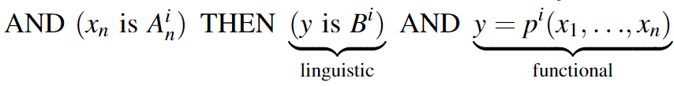
Samorazvijajoči se mehki sistemi
Mehki model:
  mehke množice (fuzzy sets) v premisi,
  lokalni linearni modeli (Local linear model) v posledičnem delu.
Poglavitne naloge samorazvijajočih se mehkih sistemov so:
  natančno funkcijsko modeliranje z modeli tipa Takagi-Sugeno-Kang,
  lingvistično (linguistic) modeliranje tipa Zadeh-Mamdani,
  klasifikacija.
Izhodno ostrenje je izvedeno z izračunom centra gravitacije pri lingvističnih modelih, uteženega povprečja (weighted average) pri funkcijskih modelih in model z največjo aktivacijo (winner-takes-all) pri klasifikaciji
[11]
[11] Leite, D., Ballini, R., Costa, P., & Gomide, F. (2012). Evolving fuzzy granular modeling from nonstationary fuzzy data streams. Evolving Systems, 3(2), 65–79.

Slide 6
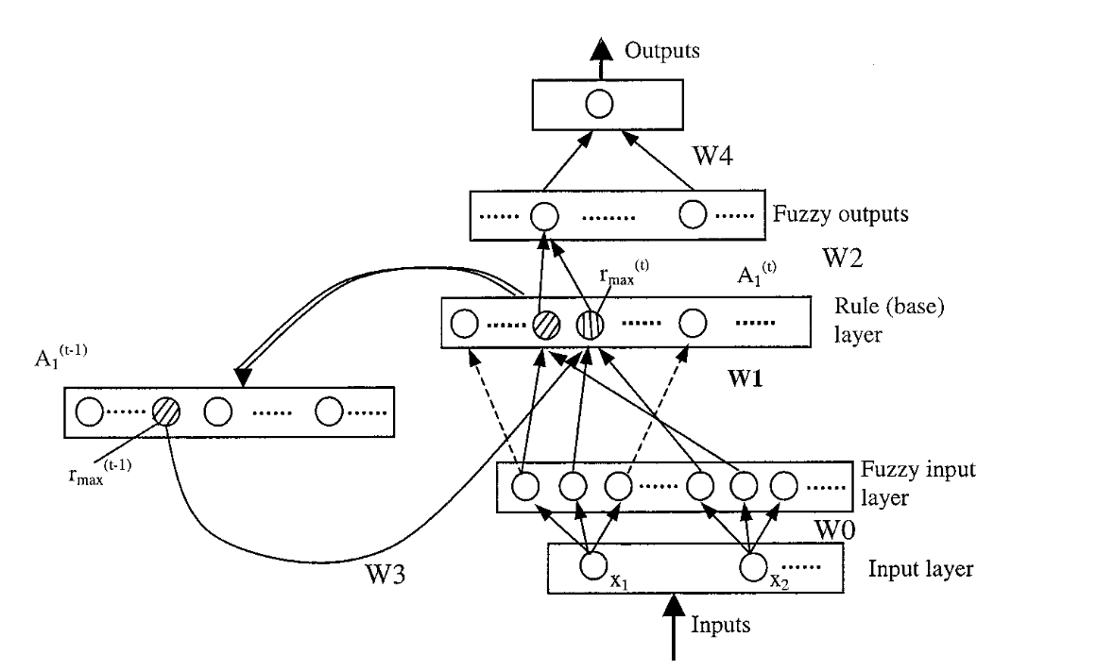
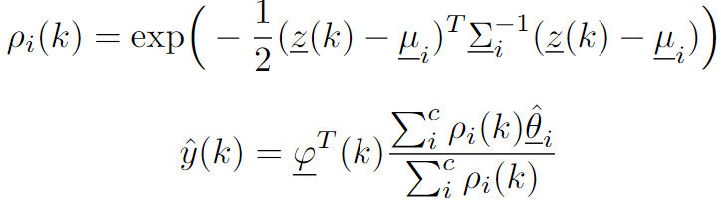
Samorazvijajoči se nevro-mehki sistemi
[13]
Nevro-mehki modeli so sestavljeni iz mehkih pravil v topologiji nevronskega omrežja z nevroni in povezavami [6]. Vedno jih lahko pretvorimo v mehki model tako, da roje preslikamo v mehke množice.
Mehka pravila lahko sestavljajo več mehkih množic (fuzzy set)[12], ampak uporaba enega pravila za vsak roj v neuro-fuzzy sistemih poenostavi adaptiranje strukture modela z združevanjem (merging), ločevanjem (splitting) in odstranjevanjem (removal) pravil.
[6] Leite, D., Škrjanc, I., & Gomide, F. (2020). An overview on evolving systems and learning from stream data. Evolving Systems, 11(2), 181–198.
[12] Angelov, P., & Yager, R. (2011). Simplified fuzzy rule-based systems using non-parametric antecedents and relative data density. IEEE SSCI 2011: Symposium Series on Computational Intelligence - EAIS 2011: 2011 IEEE Workshop on Evolving and Adaptive Intelligent Systems, 62–69.
[13] Kasabov, N. K., & Song, Q. (2002). DENFIS: Dynamic evolving neural-fuzzy inference system and its application for time-series prediction. IEEE Transactions on Fuzzy Systems, 10(2), 144–154.
Notes:
[10] Leite, D., Škrjanc, I., & Gomide, F. (2020). An overview on evolving systems and learning from stream data. Evolving Systems, 11(2), 181–198.
[41] Angelov, P., & Yager, R. (2011). Simplified fuzzy rule-based systems using non-parametric antecedents and relative data density. IEEE SSCI 2011: Symposium Series on Computational Intelligence - EAIS 2011: 2011 IEEE Workshop on Evolving and Adaptive Intelligent Systems, 62–69.
[4] Kasabov, N. K., & Song, Q. (2002). DENFIS: Dynamic evolving neural-fuzzy inference system and its application for time-series prediction. IEEE Transactions on Fuzzy Systems, 10(2), 144–154.

Slide 7
Transparentnost in interpretabilnost
Razločljivost (distinguishability ) – brez prekrivanja (overlapping), brez odvečnih struktur,
Preprostost (simplicity ) – čim manj rojev, kompromis med natančnostjo in kompleksnostjo,
Konsistentnost (consistency) – roji z različnimi posledičnimi deli morajo biti ločeni,
Pokritost (coverage) in popolnost modela (completeness) – celoten prostor naj bi bil pokrit z roji,
Interpretabilnost posledičnega dela,
Pomembnost značilk,
Pomembnost pravil.
[8] [12] Lughofer, E. (2013). On-line assurance of interpretability criteria in evolving fuzzy systems – Achievements, new concepts and open issues. Information Sciences, 251, 22–46.
Notes:
Razločljivost (Distinguishability ) – brez prekrivanja (overlapping), brez odvečnih struktur [12]
Preprostost (simplicity ) – čim manj rojev, kompromis med natančnostjo in kompleksnotjo
Konsistentnost (consistency) – roji z različnimi posledičnimi deli morajo biti ločeni
Pokritost (coverage) in popolnost modela (completeness) - celoten prostor naj bi bil pokrit z roji
Interpretabilnost posledičnega dela
Pomembnost značilk
Pomembnost pravil
[12] Lughofer, E. (2013). On-line assurance of interpretability criteria in evolving fuzzy systems – Achievements, new concepts and open issues. Information Sciences, 251, 22–46.

Slide 8
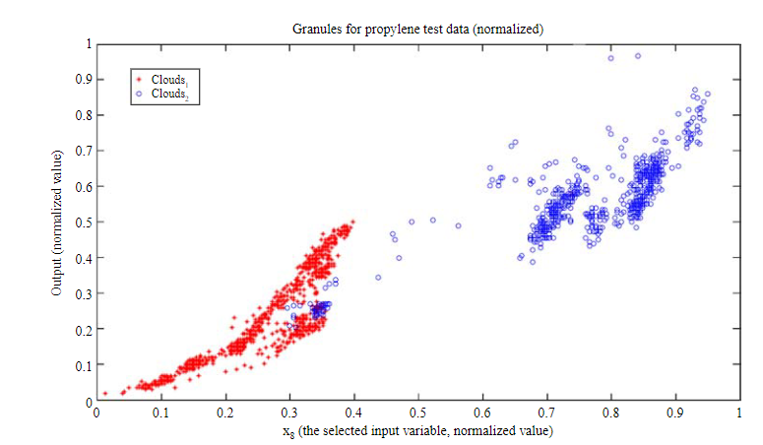
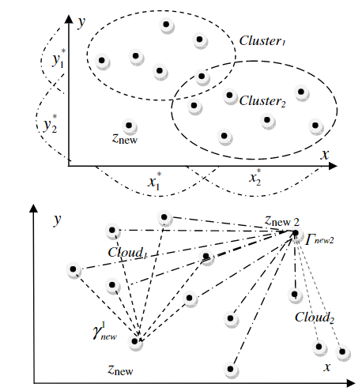
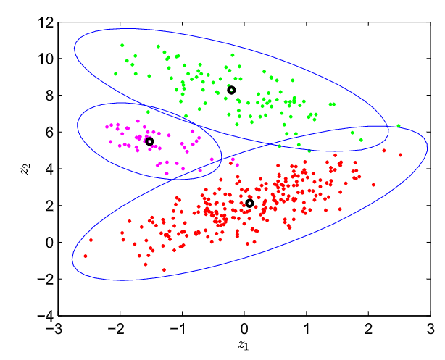
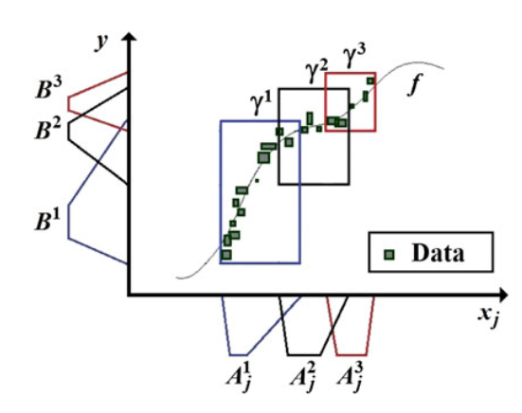
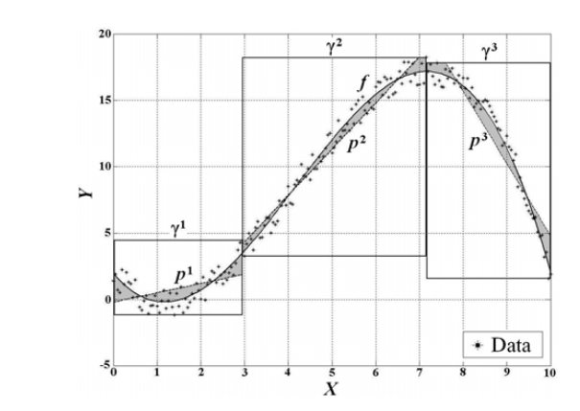
Rojenje in granulacija
Najbolj pogosto so uporabljene Gaussove, trapezoidne ali trikote pripadnostne funkcije [10].
Predhodna (antecedent) struktura samorazvijajočih se sistemov je lahko sestavljena iz mehkih možic [1], informacijskih granul [14, 5 ,11], listov, nevronov, oblakov podatkov (data clouds) [12,15], rojev [3, 14, 2], hiperravnin [16], teselacij (tessellation)[9] idr.
Informacijske granule so skupine objektov ali elementov s podobnimi lastnostmi, funkcionalnostjo, prostorsko bližino [12], [5]. Nekateri modeli predstavijo granule v obliki oblakov podatkov brez centrov ali definiranih mej [12].
[1] Angelov, P. P., & Filev, D. P. (2004). An Approach to Online Identification of Takagi-Sugeno Fuzzy Models. IEEE Transactions on Systems, Man, and Cybernetics, Part B: Cybernetics, 34(1), 484–498.
[2] Skrjanc, I. (2020). Cluster-Volume-Based Merging Approach for Incrementally Evolving Fuzzy Gaussian Clustering-eGAUSS+. IEEE Transactions on Fuzzy Systems, 28(9), 2222–2231.
[3] Dovžan, D., Logar, V., & Škrjanc, I. (2015). Implementation of an Evolving Fuzzy Model (eFuMo) in a Monitoring System for a Waste-Water Treatment Process. IEEE Transactions on Fuzzy Systems, 23(5), 1761–1776.
[5] Leite, D., Costa, P., & Gomide, F. (2010). Granular Approach for Evolving System Modeling. Lecture Notes in Computer Science (Including Subseries Lecture Notes in Artificial Intelligence and Lecture Notes in Bioinformatics), 6178 LNAI, 340–349.
[9] Blazic, S., & Skrjanc, I. (2020). Hybrid system identification by incremental fuzzy C-regression clustering. IEEE International Conference on Fuzzy Systems, 2020-July.
[10] Angelov, P. P., Gu, X., & Principe, J. C. (2018). Autonomous learning multimodel systems from data streams. IEEE Transactions on Fuzzy Systems, 26(4), 2213–2224.
[11] Leite, D., Ballini, R., Costa, P., & Gomide, F. (2012). Evolving fuzzy granular modeling from nonstationary fuzzy data streams. Evolving Systems, 3(2), 65–79. [12] Angelov, P., & Yager, R. (2011). Simplified fuzzy rule-based systems using non-parametric antecedents and relative data density. IEEE SSCI 2011: Symposium Series on Computational Intelligence - EAIS 2011: 2011 IEEE Workshop on Evolving and Adaptive Intelligent Systems, 62–69.
[14] Porto, A., & Gomide, F. (2022). Evolving hyperbox fuzzy modeling. Evolving Systems, 1, 1–12.
[15] Angelov, P., & Yager, R. (2012). A new type of simplified fuzzy rule-based system. International Journal of General Systems, 41(2), 163–185.
Notes:
Dejanska porazdelitev podatkov se lahko zelo razlikuje od pripadnostnih funkciji.
[45] Angelov, P. P., Gu, X., & Principe, J. C. (2018). Autonomous learning multimodel systems from data streams. IEEE Transactions on Fuzzy Systems, 26(4), 2213–2224.
[3] Angelov, P. P., & Filev, D. P. (2004). An Approach to Online Identification of Takagi-Sugeno Fuzzy Models. IEEE Transactions on Systems, Man, and Cybernetics, Part B: Cybernetics, 34(1), 484–498.
[9] Porto, A., & Gomide, F. (2022). Evolving hyperbox fuzzy modeling. Evolving Systems, 1, 1–12.
[11] Leite, D., Costa, P., & Gomide, F. (2010). Granular Approach for Evolving System Modeling. Lecture Notes in Computer Science (Including Subseries Lecture Notes in Artificial Intelligence and Lecture Notes in Bioinformatics), 6178 LNAI, 340–349.
[41] Angelov, P., & Yager, R. (2011). Simplified fuzzy rule-based systems using non-parametric antecedents and relative data density. IEEE SSCI 2011: Symposium Series on Computational Intelligence - EAIS 2011: 2011 IEEE Workshop on Evolving and Adaptive Intelligent Systems, 62–69.
[46] Angelov, P., & Yager, R. (2012). A new type of simplified fuzzy rule-based system. International Journal of General Systems, 41(2), 163–185.
[5] Dovžan, D., Logar, V., & Škrjanc, I. (2015). Implementation of an Evolving Fuzzy Model (eFuMo) in a Monitoring System for a Waste-Water Treatment Process. IEEE Transactions on Fuzzy Systems, 23(5), 1761–1776.
[9] Porto, A., & Gomide, F. (2022). Evolving hyperbox fuzzy modeling. Evolving Systems, 1, 1–12.
[43] Skrjanc, I. (2020). Cluster-Volume-Based Merging Approach for Incrementally Evolving Fuzzy Gaussian Clustering-eGAUSS+. IEEE Transactions on Fuzzy Systems, 28(9), 2222–2231.
[16] Dovzan, D., & Skrjanc, I. (2020). Fuzzy Space Partitioning Based on Hyperplanes Defined by Eigenvectors for Takagi-Sugeno Fuzzy Model Identification. IEEE Transactions on Industrial Electronics, 67(6), 5144–5153.
[54] Leite, D., Ballini, R., Costa, P., & Gomide, F. (2012). Evolving fuzzy granular modeling from nonstationary fuzzy data streams. Evolving Systems, 3(2), 65–79.

Slide 9



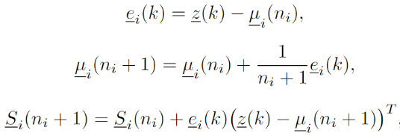
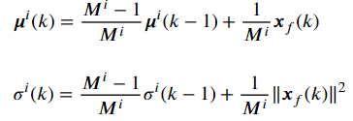
Metode rojenja
[19]
[20]
[2]
Odštevalno rojenje (subtractive clustering) [1, 15],
mehko rojenje s C-središči (Fuzzy C-means),
rekurzivno rojenje po metodi Gustafson-Kessel [3,16],
rekurzivno rojenje po metodi Gath-Geva [17],
samorazvijajoče se rojenje (evolving clustering method) [13],
inkrementalno mehko rojenje s C-regresijo (incremental fuzzy C-regression clustering) [9],
rojenje s C-možnimi roji (possibilistic C-means),
rojenje na osnovi gostote (density-based)[12],
rojenje na osnovi razpršenosti (scatter-based) [18],
rojenje s vektorsko kvantizacijo (vector quantization) [19],
samorazvijajoče se Gaussovo rojenje (eGauss)[2] idr.
[1] Angelov, P. P., & Filev, D. P. (2004). An Approach to Online Identification of Takagi-Sugeno Fuzzy Models. IEEE Transactions on Systems, Man, and Cybernetics, Part B: Cybernetics, 34(1), 484–498.
[2] Skrjanc, I. (2020). Cluster-Volume-Based Merging Approach for Incrementally Evolving Fuzzy Gaussian Clustering-eGAUSS+. IEEE Transactions on Fuzzy Systems, 28(9), 2222–2231.
[3] Dovžan, D., Logar, V., & Škrjanc, I. (2015). Implementation of an Evolving Fuzzy Model (eFuMo) in a Monitoring System for a Waste-Water Treatment Process. IEEE Transactions on Fuzzy Systems, 23(5), 1761–1776.
[9] Blazic, S., & Skrjanc, I. (2020). Hybrid system identification by incremental fuzzy C-regression clustering. IEEE International Conference on Fuzzy Systems, 2020-July.
[12] Angelov, P., & Yager, R. (2011). Simplified fuzzy rule-based systems using non-parametric antecedents and relative data density. IEEE SSCI 2011: Symposium Series on Computational Intelligence - EAIS 2011: 2011 IEEE Workshop on Evolving and Adaptive Intelligent Systems, 62–69.
[13] Kasabov, N. K., & Song, Q. (2002). DENFIS: Dynamic evolving neural-fuzzy inference system and its application for time-series prediction. IEEE Transactions on Fuzzy Systems, 10(2), 144–154.
[15] Angelov, P., & Yager, R. (2012). A new type of simplified fuzzy rule-based system. International Journal of General Systems, 41(2), 163–185.
[16] Dovžan, D., & Škrjanc, I. (2011). Recursive clustering based on a Gustafson-Kessel algorithm. Evolving Systems, 2(1), 15–24.
[17] Soleimani-B, H., Lucas, C., & Araabi, B. N. (2010). Recursive Gath-Geva clustering as a basis for evolving neuro-fuzzy modeling. Evolving Systems, 1(1), 59–71.
[18] D. Leite, I. Škrjanc, and F. Gomide, “An overview on evolving systems and learning from stream data,” Evolving Systems, vol. 11, no. 2, pp. 181–198, Jun. 2020.
[19] Lughofer, E. D. (2008). FLEXFIS: A robust incremental learning approach for evolving Takagi-Sugeno fuzzy models. IEEE Transactions on Fuzzy Systems, 16(6), 1393–1410.
[20] Andonovski, G., Mušič, G., Blažič, S., & Škrjanc, I. (2018). Evolving model identification for process monitoring and prediction of non-linear systems. Engineering Applications of Artificial Intelligence, 68, 214–221.
Notes:
incremental fuzzy C-regression clustering -> The parameters of the consequent part are the prototypes used in clustering, Hyperplane parameters can be shared between in the premise and consequent part of the locally linear models.
Subtractive Clustering a version of mountain clustering
Stability refers to the long-term solution convergence and Plasticity to the dynamic concept change handling [12, 49]
[3] Angelov, P. P., & Filev, D. P. (2004). An Approach to Online Identification of Takagi-Sugeno Fuzzy Models. IEEE Transactions on Systems, Man, and Cybernetics, Part B: Cybernetics, 34(1), 484–498.
[46] Angelov, P., & Yager, R. (2012). A new type of simplified fuzzy rule-based system. International Journal of General Systems, 41(2), 163–185.
[5] Dovžan, D., Logar, V., & Škrjanc, I. (2015). Implementation of an Evolving Fuzzy Model (eFuMo) in a Monitoring System for a Waste-Water Treatment Process. IEEE Transactions on Fuzzy Systems, 23(5), 1761–1776.
[13] Dovžan, D., & Škrjanc, I. (2011). Recursive clustering based on a Gustafson-Kessel algorithm. Evolving Systems, 2(1), 15–24.
[14] Soleimani-B, H., Lucas, C., & Araabi, B. N. (2010). Recursive Gath-Geva clustering as a basis for evolving neuro-fuzzy modeling. Evolving Systems, 1(1), 59–71.
[4] Kasabov, N. K., & Song, Q. (2002). DENFIS: Dynamic evolving neural-fuzzy inference system and its application for time-series prediction. IEEE Transactions on Fuzzy Systems, 10(2), 144–154.
[31] Blazic, S., & Skrjanc, I. (2020). Hybrid system identification by incremental fuzzy C-regression clustering. IEEE International Conference on Fuzzy Systems, 2020-July.
[39] Andonovski, G., Mušič, G., Blažič, S., & Škrjanc, I. (2018). Evolving model identification for process monitoring and prediction of non-linear systems. Engineering Applications of Artificial Intelligence, 68, 214–221.
[41] Angelov, P., & Yager, R. (2011). Simplified fuzzy rule-based systems using non-parametric antecedents and relative data density. IEEE SSCI 2011: Symposium Series on Computational Intelligence - EAIS 2011: 2011 IEEE Workshop on Evolving and Adaptive Intelligent Systems, 62–69.
[8] D. Leite, I. Škrjanc, and F. Gomide, “An overview on evolving systems and learning from stream data,” Evolving Systems, vol. 11, no. 2, pp. 181–198, Jun. 2020.
[49] Lughofer, E. D. (2008). FLEXFIS: A robust incremental learning approach for evolving Takagi-Sugeno fuzzy models. IEEE Transactions on Fuzzy Systems, 16(6), 1393–1410.
[43] Skrjanc, I. (2020). Cluster-Volume-Based Merging Approach for Incrementally Evolving Fuzzy Gaussian Clustering-eGAUSS+. IEEE Transactions on Fuzzy Systems, 28(9), 2222–2231.

Slide 10
Dodajanje rojev
Razdalja novega vzorca (Evklidova, Mahalanobisova) do obstoječih struktur [19,13,3],
Pripadnost novega vzorca obstoječim strukturam (є-completeness) [1],
Potencial (potential) vzorca [1],
Gostota (density) vzorca [20],
Največje dovoljeno število rojev [20],
Število vzorcev od zadnjega dodanega roja [20]idr.
Dodani roji so inicializirani z ničtimi vrednostmi, s povprečjem bližnjih rojev [10], s minimalno pokritostjo prostora idr.
[1] Angelov, P. P., & Filev, D. P. (2004). An Approach to Online Identification of Takagi-Sugeno Fuzzy Models. IEEE Transactions on Systems, Man, and Cybernetics, Part B: Cybernetics, 34(1), 484–498.
[3] Dovžan, D., Logar, V., & Škrjanc, I. (2015). Implementation of an Evolving Fuzzy Model (eFuMo) in a Monitoring System for a Waste-Water Treatment Process. IEEE Transactions on Fuzzy Systems, 23(5), 1761–1776.
[10] Angelov, P. P., Gu, X., & Principe, J. C. (2018). Autonomous learning multimodel systems from data streams. IEEE Transactions on Fuzzy Systems, 26(4), 2213–2224.
[13] Kasabov, N. K., & Song, Q. (2002). DENFIS: Dynamic evolving neural-fuzzy inference system and its application for time-series prediction. IEEE Transactions on Fuzzy Systems, 10(2), 144–154.
[19] Lughofer, E. D. (2008). FLEXFIS: A robust incremental learning approach for evolving Takagi-Sugeno fuzzy models. IEEE Transactions on Fuzzy Systems, 16(6), 1393–1410.
[20] Andonovski, G., Mušič, G., Blažič, S., & Škrjanc, I. (2018). Evolving model identification for process monitoring and prediction of non-linear systems. Engineering Applications of Artificial Intelligence, 68, 214–221.
Notes:
[4] Kasabov, N. K., & Song, Q. (2002). DENFIS: Dynamic evolving neural-fuzzy inference system and its application for time-series prediction. IEEE Transactions on Fuzzy Systems, 10(2), 144–154.
[5] Dovžan, D., Logar, V., & Škrjanc, I. (2015). Implementation of an Evolving Fuzzy Model (eFuMo) in a Monitoring System for a Waste-Water Treatment Process. IEEE Transactions on Fuzzy Systems, 23(5), 1761–1776.
[49] Lughofer, E. D. (2008). FLEXFIS: A robust incremental learning approach for evolving Takagi-Sugeno fuzzy models. IEEE Transactions on Fuzzy Systems, 16(6), 1393–1410.
[3] Angelov, P. P., & Filev, D. P. (2004). An Approach to Online Identification of Takagi-Sugeno Fuzzy Models. IEEE Transactions on Systems, Man, and Cybernetics, Part B: Cybernetics, 34(1), 484–498.
[39] Andonovski, G., Mušič, G., Blažič, S., & Škrjanc, I. (2018). Evolving model identification for process monitoring and prediction of non-linear systems. Engineering Applications of Artificial Intelligence, 68, 214–221.
[45] Angelov, P. P., Gu, X., & Principe, J. C. (2018). Autonomous learning multimodel systems from data streams. IEEE Transactions on Fuzzy Systems, 26(4), 2213–2224.

Slide 11
Združevanje, razcep in odstranjevanje rojev
Združevanje (merging), razcep (splitting) in odstranjevanje (removal) rojev. Naključni vzorci iz toka podatkov ustvarijo prekomerno število rojev. Z dodajanjem vzorcev ali zaradi lezenja sistema (drift) [21]:
  približevanje rojev (coalescence),
  separacija rojev (delamination).
Združevanje in razcep rojev lahko kompenzira za slabo izbiro hiperparametrov metode [19].
Kompromis med dolgoročno stabilnostjo in kratkoročno plastičnostjo (stability-plasticity dilemma) [8, 19].
Z odstranjevanjem rojev povečamo natančnost ali poenostavimo strukturo modela. Obstoječ model je lahko napačen zaradi osamelcev ali sprememb v lastnostih sistema [22].
[8] Lughofer, E. (2013). On-line assurance of interpretability criteria in evolving fuzzy systems – Achievements, new concepts and open issues. Information Sciences, 251, 22–46.
[19] Lughofer, E. D. (2008). FLEXFIS: A robust incremental learning approach for evolving Takagi-Sugeno fuzzy models. IEEE Transactions on Fuzzy Systems, 16(6), 1393–1410.
[21] Lughofer, E., & Sayed-Mouchaweh, M. (2015). Autonomous data stream clustering implementing split-and-merge concepts – Towards a plug-and-play approach. Information Sciences, 304, 54–79.
[22] Lughofer, E. (2008). Extensions of vector quantization for incremental clustering. Pattern Recognition, 41(3), 995–1011.
Notes:
. Rule merging is not the same as fuzzy set merging [12] as multiple fuzzy sets can be associated with a rule depending on the formulation
[6] Lughofer, E., & Sayed-Mouchaweh, M. (2015). Autonomous data stream clustering implementing split-and-merge concepts – Towards a plug-and-play approach. Information Sciences, 304, 54–79.
[49] Lughofer, E. D. (2008). FLEXFIS: A robust incremental learning approach for evolving Takagi-Sugeno fuzzy models. IEEE Transactions on Fuzzy Systems, 16(6), 1393–1410.
[12] Lughofer, E. (2013). On-line assurance of interpretability criteria in evolving fuzzy systems – Achievements, new concepts and open issues. Information Sciences, 251, 22–46.
[53] Lughofer, E. (2008). Extensions of vector quantization for incremental clustering. Pattern Recognition, 41(3), 995–1011.

Slide 12
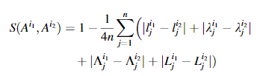
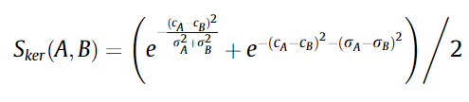







Pogoji za združevanje rojev
prekrivanje in mere verjetnostne različnosti rojev [3] (Kullback–Leiblerjeva divergenca, Bhattacharyyajeva razdalja [21]),
podobnosti med aktivacijami pravil [3],
razdalje med roji (Welch test) [3,17,23,24] ali informacijskimi granuli [11],
primerjava posledičnih parametrov [3,25] idr.
[11]
[21]
[6]
[3]
[17]
[24]
[3]
[25]
[17]
[3]
[3] Dovžan, D., Logar, V., & Škrjanc, I. (2015). Implementation of an Evolving Fuzzy Model (eFuMo) in a Monitoring System for a Waste-Water Treatment Process. IEEE Transactions on Fuzzy Systems, 23(5), 1761–1776.
[11] Leite, D., Ballini, R., Costa, P., & Gomide, F. (2012). Evolving fuzzy granular modeling from nonstationary fuzzy data streams. Evolving Systems, 3(2), 65–79.
[17] Soleimani-B, H., Lucas, C., & Araabi, B. N. (2010). Recursive Gath-Geva clustering as a basis for evolving neuro-fuzzy modeling. Evolving Systems, 1(1), 59–71.
[21] Lughofer, E., & Sayed-Mouchaweh, M. (2015). Autonomous data stream clustering implementing split-and-merge concepts – Towards a plug-and-play approach. Information Sciences, 304, 54–79.
[23] E. Lima, M. Hell, R. Ballini, F. Gomide, Evolving fuzzy modeling using participatory learning, in: P. Angelov, D. Filev, N. Kasabov (Eds.), EvolvingIntelligent Systems: Methodology and Applications, John Wiley & Sons, New York, 2010, pp. 67–86.
[24] Lughofer, E., Bouchot, J. L., & Shaker, A. (2011). On-line elimination of local redundancies in evolving fuzzy systems. Evolving Systems, 2(3), 165–187.
[25] Andonovski, G., Lughofer, E., & Skrjanc, I. (2021). Evolving Fuzzy Model Identification of Nonlinear Wiener-Hammerstein Processes. IEEE Access, 9, 158470–158480.
Notes:
[5] Dovžan, D., Logar, V., & Škrjanc, I. (2015). Implementation of an Evolving Fuzzy Model (eFuMo) in a Monitoring System for a Waste-Water Treatment Process. IEEE Transactions on Fuzzy Systems, 23(5), 1761–1776.
[6] Lughofer, E., & Sayed-Mouchaweh, M. (2015). Autonomous data stream clustering implementing split-and-merge concepts – Towards a plug-and-play approach. Information Sciences, 304, 54–79.
[14] Soleimani-B, H., Lucas, C., & Araabi, B. N. (2010). Recursive Gath-Geva clustering as a basis for evolving neuro-fuzzy modeling. Evolving Systems, 1(1), 59–71.
[17] E. Lima, M. Hell, R. Ballini, F. Gomide, Evolving fuzzy modeling using participatory learning, in: P. Angelov, D. Filev, N. Kasabov (Eds.), EvolvingIntelligent Systems: Methodology and Applications, John Wiley & Sons, New York, 2010, pp. 67–86.
[19] Andonovski, G., Lughofer, E., & Skrjanc, I. (2021). Evolving Fuzzy Model Identification of Nonlinear Wiener-Hammerstein Processes. IEEE Access, 9, 158470–158480.
[54] Leite, D., Ballini, R., Costa, P., & Gomide, F. (2012). Evolving fuzzy granular modeling from nonstationary fuzzy data streams. Evolving Systems, 3(2), 65–79.
[20] Lughofer, E., Bouchot, J. L., & Shaker, A. (2011). On-line elimination of local redundancies in evolving fuzzy systems. Evolving Systems, 2(3), 165–187.

Slide 13
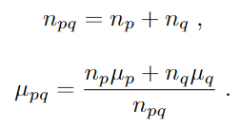
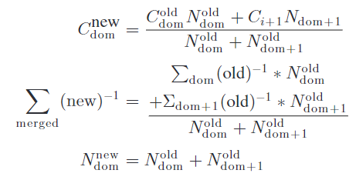
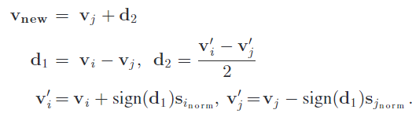


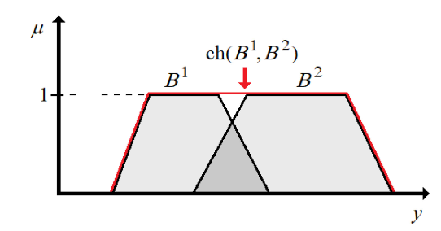
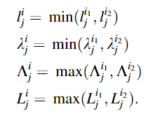
Združevanje rojev
rekurzivno uteženo povprečje središč in kovariančnih matrik rojev [3,
2,26]
konveksna ovojnica (convex hull) granul [27,11].
[2]
[3]
[26]
[2] Skrjanc, I. (2020). Cluster-Volume-Based Merging Approach for Incrementally Evolving Fuzzy Gaussian Clustering-eGAUSS+. IEEE Transactions on Fuzzy Systems, 28(9), 2222–2231.
[3] Dovžan, D., Logar, V., & Škrjanc, I. (2015). Implementation of an Evolving Fuzzy Model (eFuMo) in a Monitoring System for a Waste-Water Treatment Process. IEEE Transactions on Fuzzy Systems, 23(5), 1761–1776.
[11] Leite, D., Ballini, R., Costa, P., & Gomide, F. (2012). Evolving fuzzy granular modeling from nonstationary fuzzy data streams. Evolving Systems, 3(2), 65–79.
[26] Pratama, M., Anavatti, S. G., & Lughofer, E. (2014). Genefis: Toward an effective localist network. IEEE Transactions on Fuzzy Systems, 22(3), 547–562.
[27] Garcia, C., Leite, D., & Skrjanc, I. (2020). Incremental Missing-Data Imputation for Evolving Fuzzy Granular Prediction. IEEE Transactions on Fuzzy Systems, 28(10), 2348–2362.
[27]
[22]
Notes:
[43] Skrjanc, I. (2020). Cluster-Volume-Based Merging Approach for Incrementally Evolving Fuzzy Gaussian Clustering-eGAUSS+. IEEE Transactions on Fuzzy Systems, 28(9), 2222–2231.
[51] Garcia, C., Leite, D., & Skrjanc, I. (2020). Incremental Missing-Data Imputation for Evolving Fuzzy Granular Prediction. IEEE Transactions on Fuzzy Systems, 28(10), 2348–2362.
[54] Leite, D., Ballini, R., Costa, P., & Gomide, F. (2012). Evolving fuzzy granular modeling from nonstationary fuzzy data streams. Evolving Systems, 3(2), 65–79.
[5] Dovžan, D., Logar, V., & Škrjanc, I. (2015). Implementation of an Evolving Fuzzy Model (eFuMo) in a Monitoring System for a Waste-Water Treatment Process. IEEE Transactions on Fuzzy Systems, 23(5), 1761–1776.
[56]Pratama, M., Anavatti, S. G., & Lughofer, E. (2014). Genefis: Toward an effective localist network. IEEE Transactions on Fuzzy Systems, 22(3), 547–562. https://doi.org/10.1109/TFUZZ.2013.2264938

Slide 14




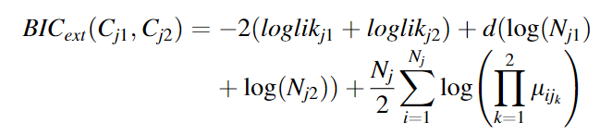
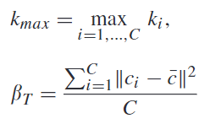
Razcep rojev
Neprimerni parametri združevanja, lezenje parametrov in konceptualni pomiki v toku podatkov, potreba po natančnejšem deljenju prostora idr.
akumulirana relativna napaka [3],
prekrivanje rojev, Welchejev T-test (Welch T-test)[21], Bayesov informacijski kriterij (Bayesian information criterion) [21, 27], partition separation index [22] idr.
[3]
[21]
[27]
[22]
[3] Dovžan, D., Logar, V., & Škrjanc, I. (2015). Implementation of an Evolving Fuzzy Model (eFuMo) in a Monitoring System for a Waste-Water Treatment Process. IEEE Transactions on Fuzzy Systems, 23(5), 1761–1776.
[21] Lughofer, E., & Sayed-Mouchaweh, M. (2015). Autonomous data stream clustering implementing split-and-merge concepts – Towards a plug-and-play approach. Information Sciences, 304, 54–79.
[22] Lughofer, E. (2008). Extensions of vector quantization for incremental clustering. Pattern Recognition, 41(3), 995–1011.
[27] Garcia, C., Leite, D., & Skrjanc, I. (2020). Incremental Missing-Data Imputation for Evolving Fuzzy Granular Prediction. IEEE Transactions on Fuzzy Systems, 28(10), 2348–2362.
Notes:
[5] Dovžan, D., Logar, V., & Škrjanc, I. (2015). Implementation of an Evolving Fuzzy Model (eFuMo) in a Monitoring System for a Waste-Water Treatment Process. IEEE Transactions on Fuzzy Systems, 23(5), 1761–1776.
[6] Lughofer, E., & Sayed-Mouchaweh, M. (2015). Autonomous data stream clustering implementing split-and-merge concepts – Towards a plug-and-play approach. Information Sciences, 304, 54–79.
[51] Garcia, C., Leite, D., & Skrjanc, I. (2020). Incremental Missing-Data Imputation for Evolving Fuzzy Granular Prediction. IEEE Transactions on Fuzzy Systems, 28(10), 2348–2362.
[53] Lughofer, E. (2008). Extensions of vector quantization for incremental clustering. Pattern Recognition, 41(3), 995–1011.

Slide 15

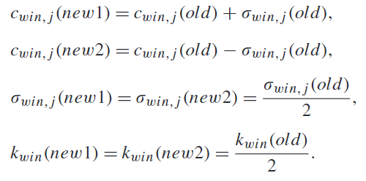
Razcep rojev
Hranjenje dodatnih struktur znotraj rojev (Gaussian mixture model) [27]
Deljenje roja v smeri največje lastne vrednosti in postavitev kovariančne matrike, števila delcev na polovico [3,22].
Nekateri samorazvijajoči sistemi primerjajo kvaliteto modela pred in po spremembi strukture [19].
[3]
[22]
[3] Dovžan, D., Logar, V., & Škrjanc, I. (2015). Implementation of an Evolving Fuzzy Model (eFuMo) in a Monitoring System for a Waste-Water Treatment Process. IEEE Transactions on Fuzzy Systems, 23(5), 1761–1776
[19] Lughofer, E. D. (2008). FLEXFIS: A robust incremental learning approach for evolving Takagi-Sugeno fuzzy models. IEEE Transactions on Fuzzy Systems, 16(6), 1393–1410.
[22] Lughofer, E. (2008). Extensions of vector quantization for incremental clustering. Pattern Recognition, 41(3), 995–1011.
[27] Garcia, C., Leite, D., & Skrjanc, I. (2020). Incremental Missing-Data Imputation for Evolving Fuzzy Granular Prediction. IEEE Transactions on Fuzzy Systems, 28(10), 2348–2362.
Notes:
[49] Lughofer, E. D. (2008). FLEXFIS: A robust incremental learning approach for evolving Takagi-Sugeno fuzzy models. IEEE Transactions on Fuzzy Systems, 16(6), 1393–1410.
[53] Lughofer, E. (2008). Extensions of vector quantization for incremental clustering. Pattern Recognition, 41(3), 995–1011.
[51] Garcia, C., Leite, D., & Skrjanc, I. (2020). Incremental Missing-Data Imputation for Evolving Fuzzy Granular Prediction. IEEE Transactions on Fuzzy Systems, 28(10), 2348–2362.
[5] Dovžan, D., Logar, V., & Škrjanc, I. (2015). Implementation of an Evolving Fuzzy Model (eFuMo) in a Monitoring System for a Waste-Water Treatment Process. IEEE Transactions on Fuzzy Systems, 23(5), 1761–1776.

Slide 16



Odstranjevanje rojev
Odstranjevanje je potrebno izvesti pazljivo, saj nočemo zavreči koristnih informaciji [20]. Osamelce ne moremo vedno izločiti, saj si zelo podobni cikličnim ali periodičnim pojavom. Ti dogodki so zastopani z manjšim številom vzorcev, ki pa vsebujejo veliko informacije.
prekrivanje,
starost rojev [3,12],
uporabnost (utility) (akumulirana relativna aktivacija, redka aktivacija, nepomembnost) [10, 12, 28, 29],
število pripadajočih vzorcev [3,20] idr.
[8]
[28]
[3] Dovžan, D., Logar, V., & Škrjanc, I. (2015). Implementation of an Evolving Fuzzy Model (eFuMo) in a Monitoring System for a Waste-Water Treatment Process. IEEE Transactions on Fuzzy Systems, 23(5), 1761–1776.
[8] Lughofer, E. (2013). On-line assurance of interpretability criteria in evolving fuzzy systems – Achievements, new concepts and open issues. Information Sciences, 251, 22–46
[10] Angelov, P. P., Gu, X., & Principe, J. C. (2018). Autonomous learning multimodel systems from data streams. IEEE Transactions on Fuzzy Systems, 26(4), 2213–2224.
[12] Angelov, P., & Yager, R. (2011). Simplified fuzzy rule-based systems using non-parametric antecedents and relative data density. IEEE SSCI 2011: Symposium Series on Computational Intelligence - EAIS 2011: 2011 IEEE Workshop on Evolving and Adaptive Intelligent Systems, 62–69.
[20] Andonovski, G., Mušič, G., Blažič, S., & Škrjanc, I. (2018). Evolving model identification for process monitoring and prediction of non-linear systems. Engineering Applications of Artificial Intelligence, 68, 214–221.
[28] Rong, H. J., Sundararajan, N., Huang, G. bin, & Saratchandran, P. (2006). Sequential Adaptive Fuzzy Inference System (SAFIS) for nonlinear system identification and prediction. Fuzzy Sets and Systems, 157(9), 1260–1275.
[29] Leite, D., & Škrjanc, I. (2019). Ensemble of evolving optimal granular experts, OWA aggregation, and time series prediction. Information Sciences, 504, 95–112.
Notes:
[48] Leite, D., & Škrjanc, I. (2019). Ensemble of evolving optimal granular experts, OWA aggregation, and time series prediction. Information Sciences, 504, 95–112.
[41] Angelov, P., & Yager, R. (2011). Simplified fuzzy rule-based systems using non-parametric antecedents and relative data density. IEEE SSCI 2011: Symposium Series on Computational Intelligence - EAIS 2011: 2011 IEEE Workshop on Evolving and Adaptive Intelligent Systems, 62–69.
[45] Angelov, P. P., Gu, X., & Principe, J. C. (2018). Autonomous learning multimodel systems from data streams. IEEE Transactions on Fuzzy Systems, 26(4), 2213–2224.
[22] Rong, H. J., Sundararajan, N., Huang, G. bin, & Saratchandran, P. (2006). Sequential Adaptive Fuzzy Inference System (SAFIS) for nonlinear system identification and prediction. Fuzzy Sets and Systems, 157(9), 1260–1275.
[5] Dovžan, D., Logar, V., & Škrjanc, I. (2015). Implementation of an Evolving Fuzzy Model (eFuMo) in a Monitoring System for a Waste-Water Treatment Process. IEEE Transactions on Fuzzy Systems, 23(5), 1761–1776.
[39] Andonovski, G., Mušič, G., Blažič, S., & Škrjanc, I. (2018). Evolving model identification for process monitoring and prediction of non-linear systems. Engineering Applications of Artificial Intelligence, 68, 214–221.

Slide 17
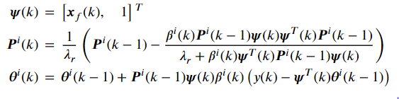
Optimizacija posledičnega dela modela
Lokalna optimizacija, kjer so parametri vsakega lokalnega modela optimizirani posamezno [30]. To omogoča večjo robustnost in interpretabilnost lokalnih modelov.
mehko utežena rekurzivna metoda najmanjših kvadratov (fuzzy weighted recursive least squares [10])
multi-innovation [31],
merilo maksimalne korentropije (maximum correntropy criterion) [31, 32],
Kalmanov filter,
stohastični gradientni spust (Stochastic gradient descent) idr.
[10] Angelov, P. P., Gu, X., & Principe, J. C. (2018). Autonomous learning multimodel systems from data streams. IEEE Transactions on Fuzzy Systems, 26(4), 2213–2224.
[30] Nelles, O. (2001). Nonlinear System Identification. Nonlinear System Identification.
[31] Lughofer, E. (2021). Improving the robustness of recursive consequent parameters learning in evolving neuro-fuzzy systems. Information Sciences, 545, 555–574.
[32] Bao, R. J., Rong, H. J., Angelov, P. P., Chen, B., & Wong, P. K. (2018). Correntropy-Based Evolving Fuzzy Neural System. IEEE Transactions on Fuzzy Systems, 26(3), 1324–1338.
Notes:
auxiliary model – Replacing an unmeasurable variable (like the noise) in the regressor/information matrix by using an estimation of the variable instead of the real value.
Hierhical principle – decomposes the system into multiple where multiple regressors are used in every optimization. ( used to identify multivariable systems or noise transfer functions).
Combining both approaches an unknown variable can be optimized in one optimization, used to estimate another regression variable and finally used in another optimization.
instrumental variables – the output of the system is replaced by the model prediction (both are present)
Correntropy - a Mercer's kernel (usually Gaussian) of the error values in the optimization criteria function used to lower the effect of outlier samples [47].
[15] Nelles, O. (2001). Nonlinear System Identification. Nonlinear System Identification.
[45] Angelov, P. P., Gu, X., & Principe, J. C. (2018). Autonomous learning multimodel systems from data streams. IEEE Transactions on Fuzzy Systems, 26(4), 2213–2224.
[47] Lughofer, E. (2021). Improving the robustness of recursive consequent parameters learning in evolving neuro-fuzzy systems. Information Sciences, 545, 555–574.
[55] Bao, R. J., Rong, H. J., Angelov, P. P., Chen, B., & Wong, P. K. (2018). Correntropy-Based Evolving Fuzzy Neural System. IEEE Transactions on Fuzzy Systems, 26(3), 1324–1338.

Slide 18
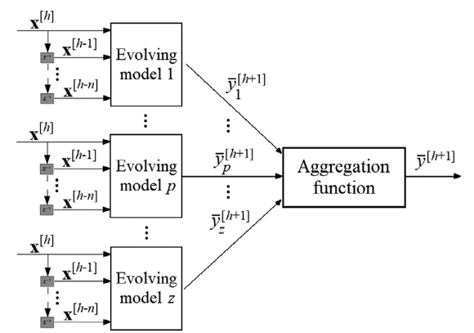
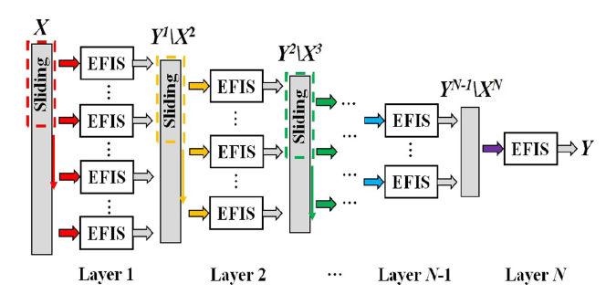

Ansambli samorazvijajočih se modelov
[29]
Učenje več različnih samorazvijajočih se modelov na istem problemu z različnimi parametri [6(10), 29(48)]$→$Ansambel/skupina (Ensemble learning).
Posamezni samorazvijajoči se modeli v ansamblu se lahko razlikujejo po: strukturi, številu parametrov, omejitvah (constraints), kriterijski funkciji, tipu samorazvijajočega se modela.
Extreme Learning Machines (ELMs) (2009) (naključna inicializacija parametrov in strukture)
Parsimonious ensemble (pENsemble) (2018) (odstranjevanje modelov in izbira značilk)
Ensamble of Fuzzy-set-Based evolving Models (FBeM) (2015) (različni parametri in strukture informacijskih granul)
Ensamble of optimal evolving granular experts (eOGS) (2019) [29] (uses multiple aggregation functions)
Multilayer ensemble evolving fuzzy inference system MEEFIS (2019) [33] (samorazvijajoči se modeli kot gradniki omrežja)
[33]
[6] Leite, D., Škrjanc, I., & Gomide, F. (2020). An overview on evolving systems and learning from stream data. Evolving Systems, 11(2), 181–198.
[29] Leite, D., & Škrjanc, I. (2019). Ensemble of evolving optimal granular experts, OWA aggregation, and time series prediction. Information Sciences, 504, 95–112.
[33] Gu, X. (2021). Multilayer Ensemble Evolving Fuzzy Inference System. IEEE Transactions on Fuzzy Systems, 29(8), 2425–2431.
Notes:
Ansambel/skupina (Ensamble learning) modelov je sestavljena iz več različnih samorazvijajočih se modelov, ki jih paralelno učimo na istem problemu z različnimi parametri [10, 48]. Posamezni samorazvijajoči se modeli v ansamblu se lahko razlikujejo po strukturi, številu parametrov, različnih omejitvah, kriterijski funkciji ali celo tipu modela. Extreme Learning Machines (ELMs) (2009) (naključna inicializacija parametrov in strukture)
Ansambli samorazvijajočih se modelov v obliki omrežja [44].
[10] Leite, D., Škrjanc, I., & Gomide, F. (2020). An overview on evolving systems and learning from stream data. Evolving Systems, 11(2), 181–198.
[44] Gu, X. (2021). Multilayer Ensemble Evolving Fuzzy Inference System. IEEE Transactions on Fuzzy Systems, 29(8), 2425–2431.
[48] Leite, D., & Škrjanc, I. (2019). Ensemble of evolving optimal granular experts, OWA aggregation, and time series prediction. Information Sciences, 504, 95–112.

Slide 19
Odprta vprašanja na področju samorazvijajočih se sistemov
obravnava manjkajočih vzorcev (missing data) in osamelcev (outliers)
teoremi za zagotavljanje dolgoročne stabilnosti in konvergence
načrtovanje experimentov (Design of Experiments)
predlogi za potek dela (workflow)
mere uspešnosti sprotnega delovanja (performance metrics)
paralelno učenje (parallelization)
programski senzorji (soft sensors)
sprotna izbira regresorjev
[6] Leite, D., Škrjanc, I., & Gomide, F. (2020). An overview on evolving systems and learning from stream data. Evolving Systems, 11(2), 181–198.
[34] Škrjanc, I., Iglesias, J., Sanchis, A., Leite, D., Lughofer, E., & Gomide, F. (2019). Evolving fuzzy and neuro-fuzzy approaches in clustering, regression, identification, and classification: A Survey. Information Sciences, 490, 344–368
Notes:
[10] Leite, D., Škrjanc, I., & Gomide, F. (2020). An overview on evolving systems and learning from stream data. Evolving Systems, 11(2), 181–198.
[27] Škrjanc, I., Iglesias, J., Sanchis, A., Leite, D., Lughofer, E., & Gomide, F. (2019). Evolving fuzzy and neuro-fuzzy approaches in clustering, regression, identification, and classification: A Survey. Information Sciences, 490, 344–368

Slide 20

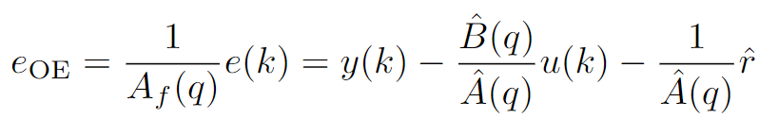
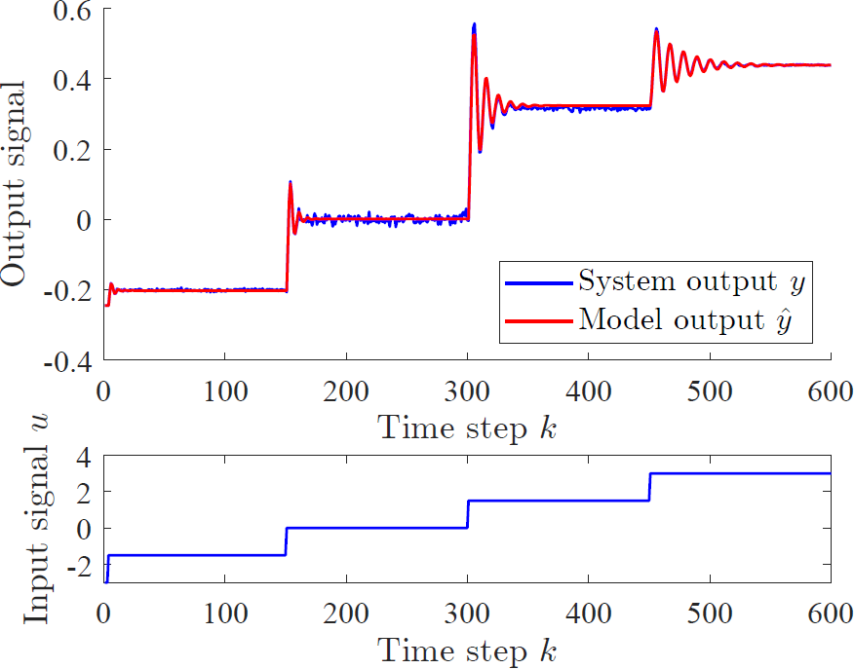
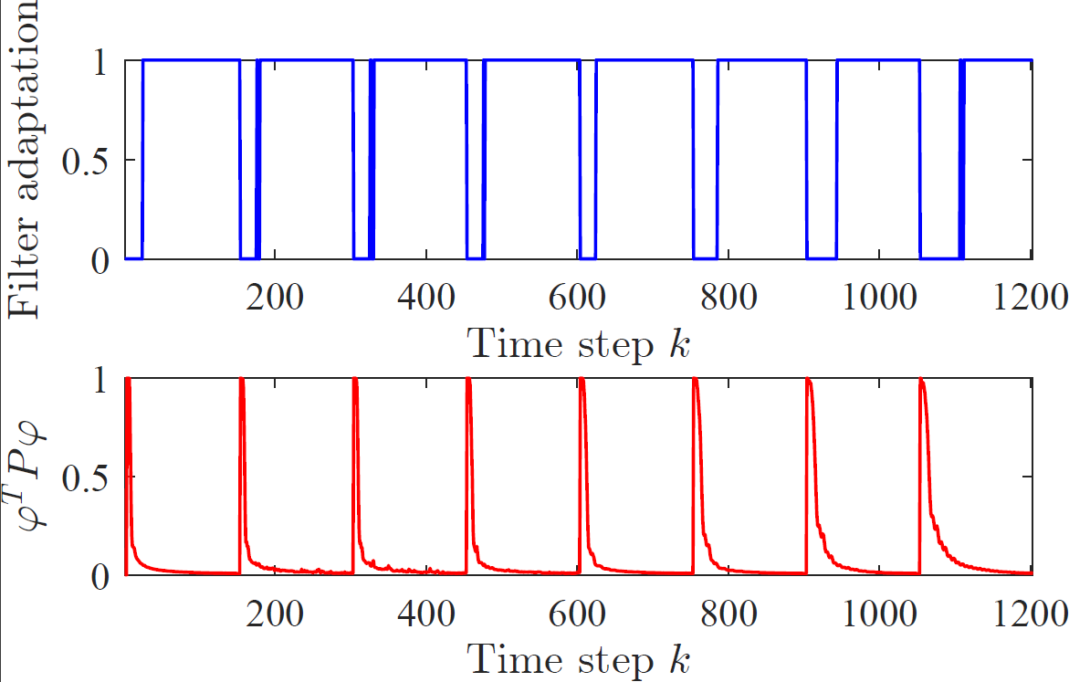

Adaptiranje filtra z intervalom zaupanja

Slide 21
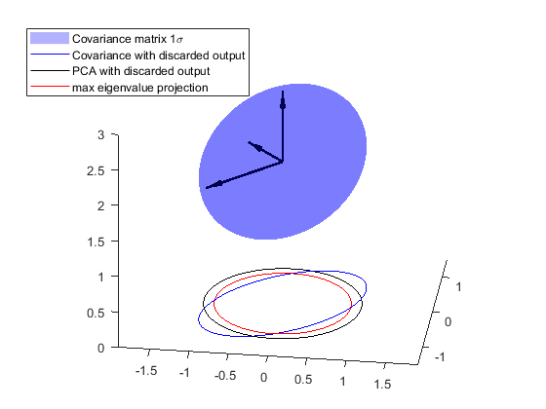
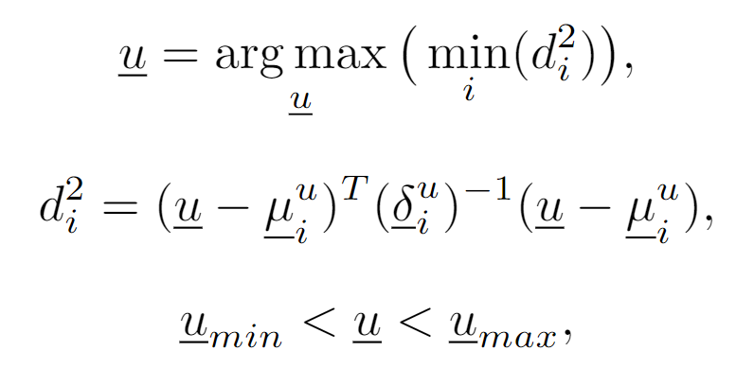
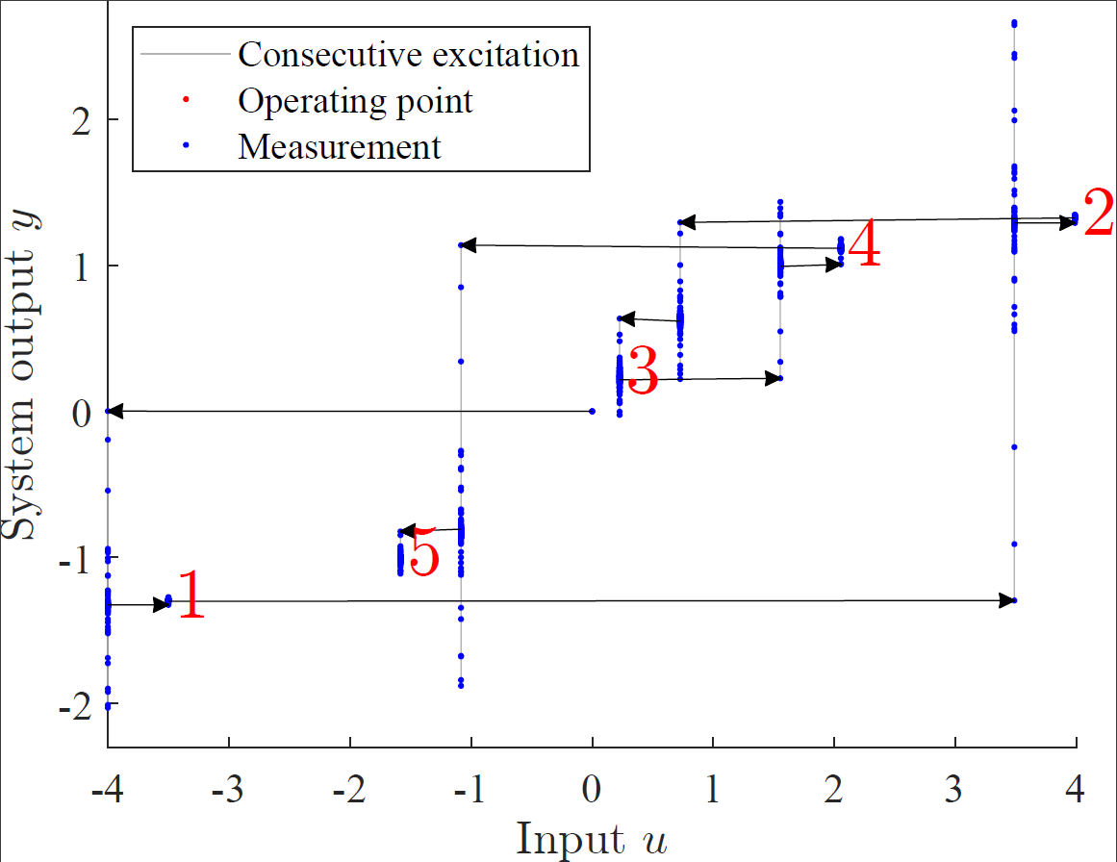
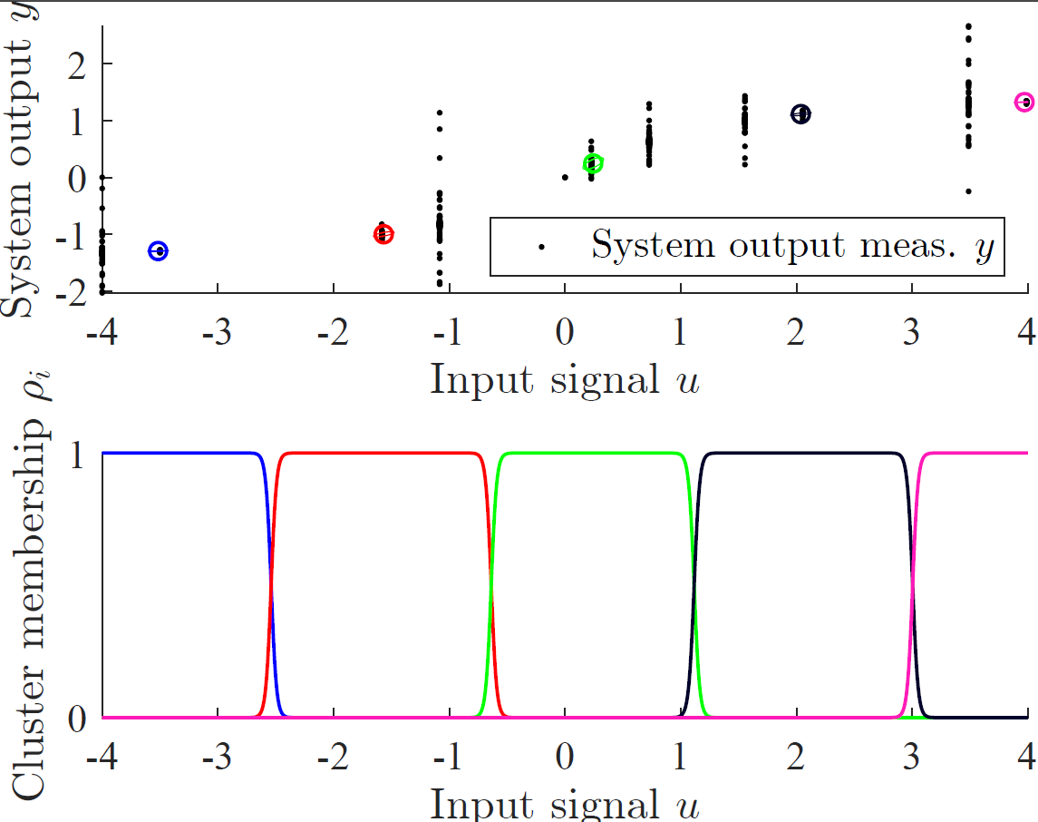
Hevristično zaporedje štopničastih vzbujanj

Slide 22
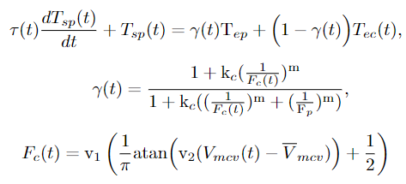


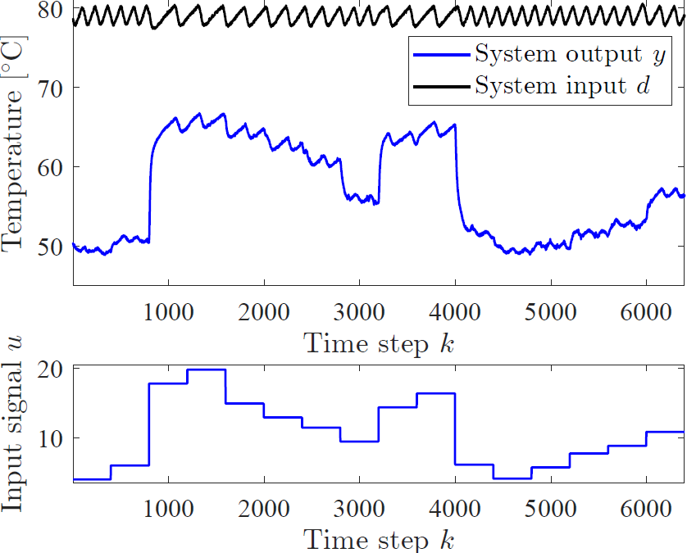
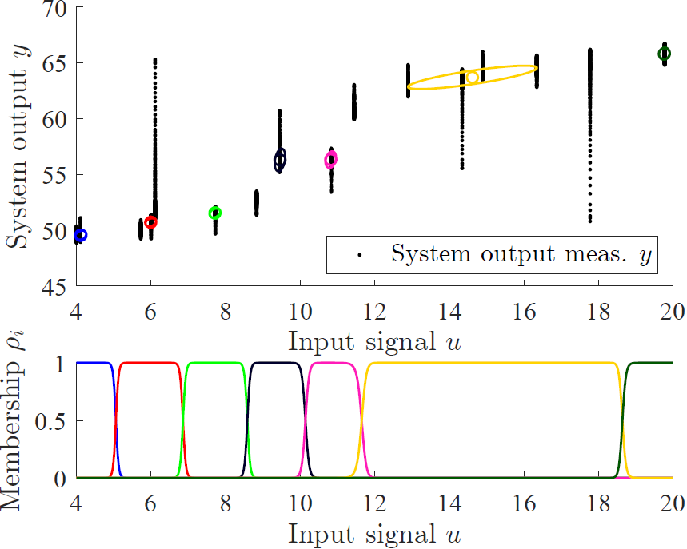
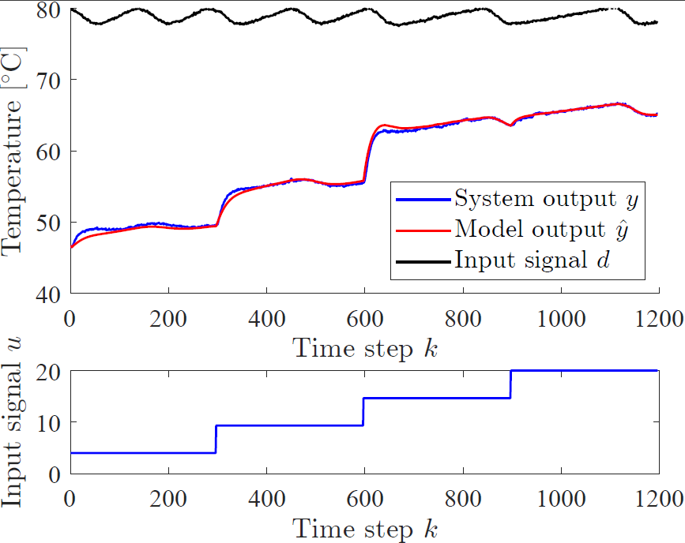
Ploskovni toplotni izmenjevalec

